Slide 1

CS 134 Computer Game Design – 3D Graphics
Instructor: Kevin M. Smith

Slide 2
CS 134 Course Outline
Physics and Simulation
3D Game Design
Game Engine Development
Team Project
2D Game Design
Introduction to Game Engines

Slide 3
Today
Big Viking Games
Maya shadows (quick demo)
Lecture: Shadow Maps
In-Class Exercise – Team Design Meeting

Slide 4
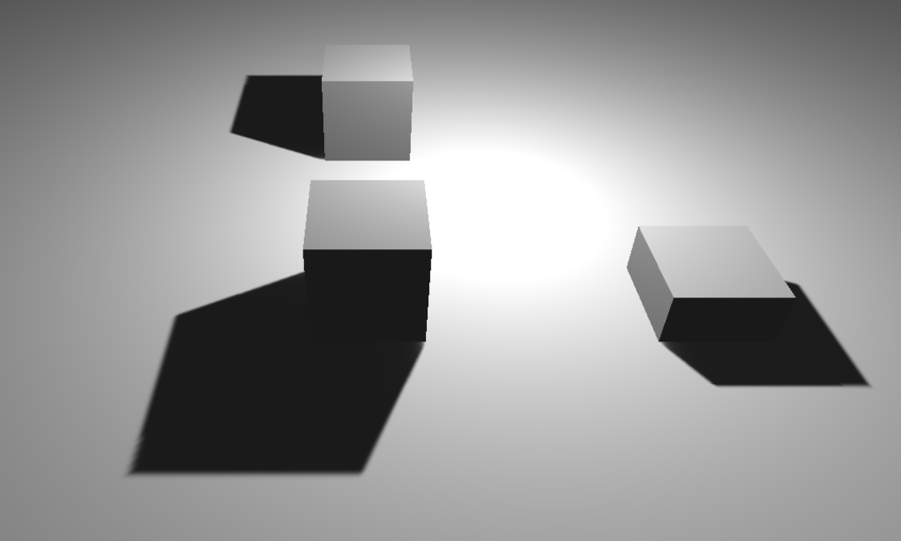
CG Shadows
Shadows add more realism to a scene
Provide a teams a space and relationship between objects (ex: object and ground plane)
They are NOT created automatically by the graphics pipeline. You have to compute them
Technique we will discuss today to compute shadows:
Shadow Mapping

Slide 5
Shadow Mapping: Basic Outline of Technique
Render a depth map from the light’s perspective
Transform points in camera view to light coordinates
Compare Z-depth of point against depth map to determine if point is in shadow.
Render Shadow: If point is in shadow, render it the shadow color (e: black) otherwise render it the normal color

Slide 6
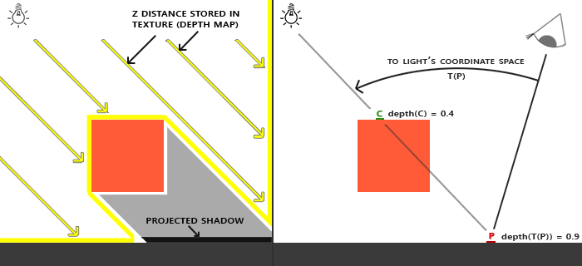
Shadow Mapping: Render Depth Map
We render a Depth Map from the light’s perspective
In other words, we render the scene through the eye of light.
The Depth Map is a two-dimensional image (texture) where each pixel in the image is a depth value equal to the distance between the light source and the object (the Z-depth).
We can use ray-intersection techniques (as previously discussed) to determine the point of intersection.
The depth map is normally stored in memory but can be stored in a file as well.

Slide 7

Depth Map
Depth Map
If we display a depth map, you will get a grey-scale image.
Each pixel only contains the depth value (no color)
The further away from the source the object will appear darker.
The closer objects appear lighter.
Occluded parts of object do not have a depth value, only visible parts of the object have depth.

Slide 8
Shadow Mapping: Transform to Light Coordinates
Now that we have the depth map, time to figure out which points in my camera view are occluded by the shadow.
The light is positioned/oriented in space and has it’s own matrix.
Just as in Camera Coordinates, we can have a coordinate system with the origin at the light from the light’s perspective.
This is called “Light Coordinates”
Looking through the camera (eye at right), we transform the point we are looking at to Light Coordinates.
This is done using a matrix transformation.
We record the (x, y, z) value of the point.
The “z” coord is the depth value from the light.

Slide 9
Shadow Mapping: Compare To Depth Map
Now that we have the point P (x, y, z) in light coordinates and we know that “z” is the depth from the light:
We look up the “z” value in the Depth Map we computed in step (1) using (x, y) components of point P.
Now we compare the z-value in the Depth Map with the value of z in the Point P.
If the value in the depth is the SAME as the value of z in the point, then the point is the same point in the depth map and is NOT occluded.
If the value in the depth map is LESS than the value of z in the point P, then the Point must be in the shadow of another object.

Slide 10
Shadow Mapping: Render Shadow
We sample points in the image to determine if they are in a shadow. (using previous steps)
If a point is in a shadow we can chose to render the point using a different pixel value
We could render it completely black, but a shadow color is usually a darkened version of the original color (some combination of the original color of the material and the shadow color you want).
There are different approached to shading/coloring the shadows once you know if the point is in a shadow.
There are enhancements that can be made to make shadow mapping more realistic.
Soft Shadows
Edge of shadow is softened or blurred

